Slide 1
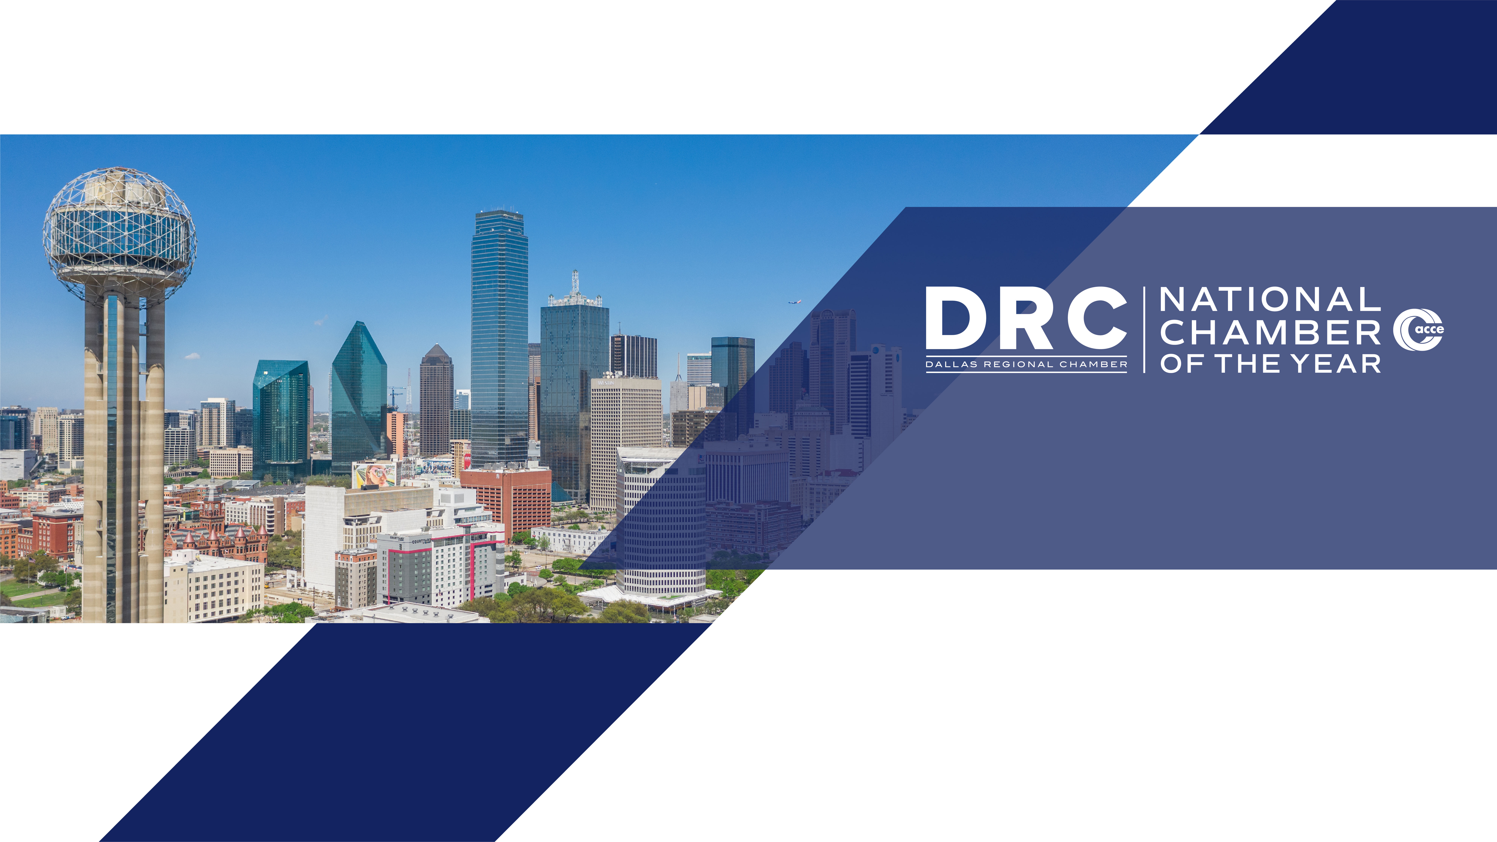
DRIVING AI FORWARD IN DALLAS-FORT WORTH
2025

Slide 2
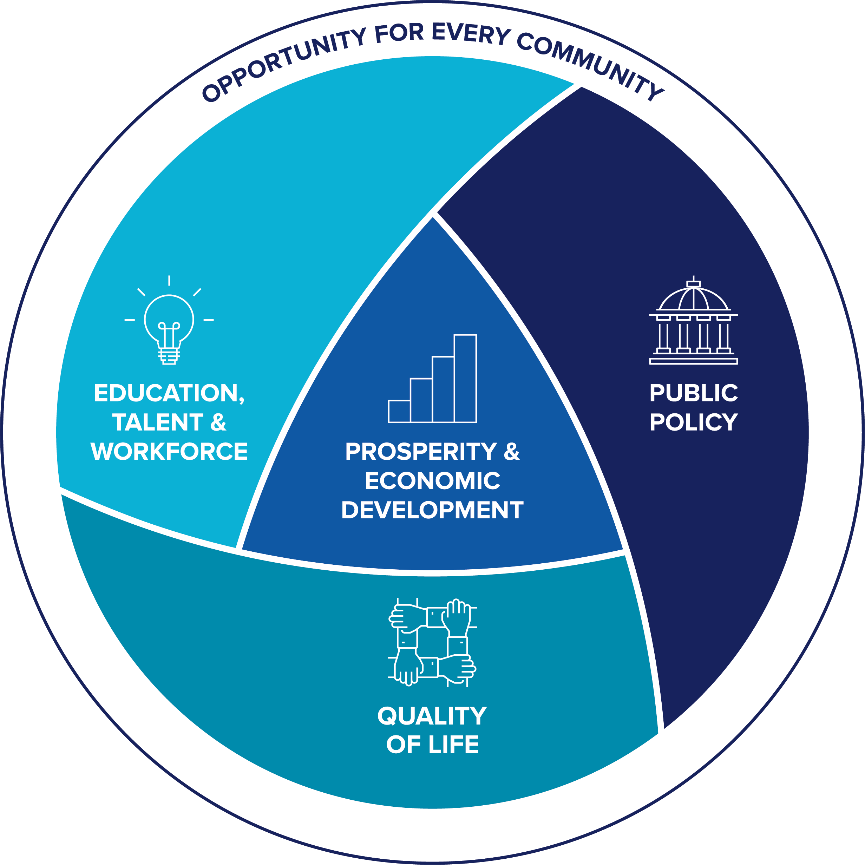
BUILDING TOMORROW TOGETHER
2024 - 2026
PROSPERITY & ECONOMIC DEVELOPMENT
We champion the growth of existing companies and the innovation ecosystem in the Dallas Region while positioning our region as a prime destination for living, working, and doing business.
EDUCATION, TALENT & WORKFORCE
We foster a talent pipeline that meets the needs of employers and prepares workers and future workers for job opportunities that lead to a fulfilling life and career.
PUBLIC POLICY
We advocate for policies and outcomes that preserve Texas’ economic competitive advantage and support a prosperous life for Texans in the near and long term.
QUALITY OF LIFE
We champion economic opportunity and help strengthen communities across the Dallas Region, creating pathways for all people and places to reach their full potential.

Slide 3


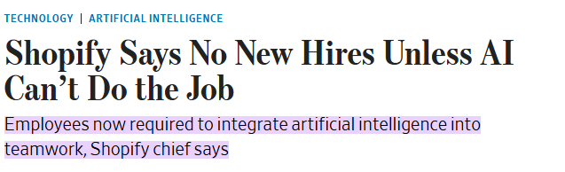
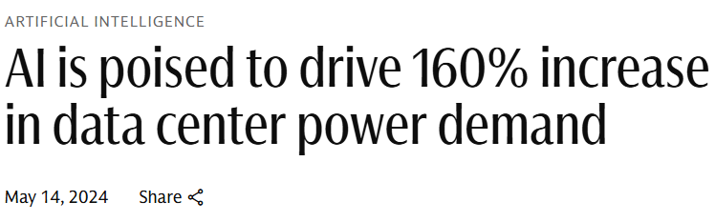
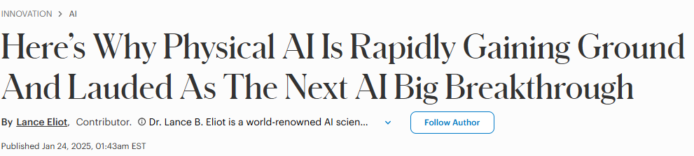

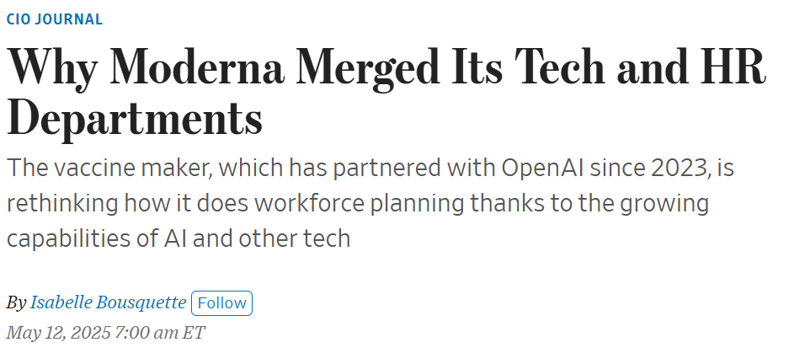
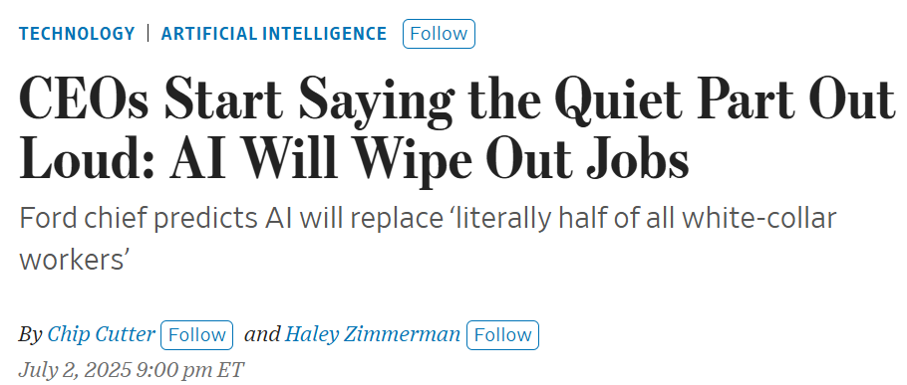
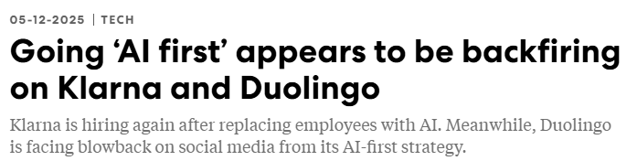



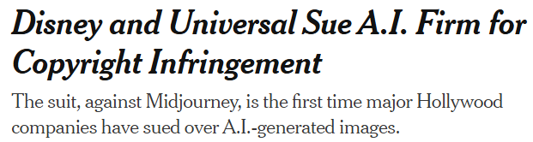
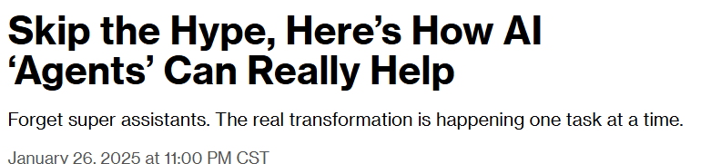
AI AND GENERATIONAL CHANGE

Slide 4
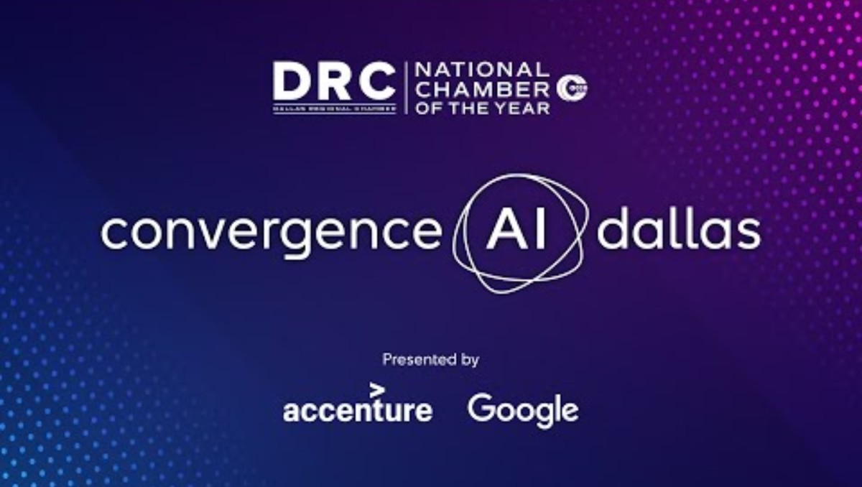

Slide 5


DFW IS THE HOME TO APPLIED AI
21
44
FORTUNE 500
COMPANIES
FORTUNE 1000
COMPANIES

Slide 6
THE DALLAS-FORT WORTH HIGH-TECH ECOSYSTEM
1st
4th
3rd
Most high-tech jobs added in the U.S.
since 2019
Highest concentration
of high-tech workers
in the U.S.
Highest concentration
of computer occupations
in the U.S.

Slide 7
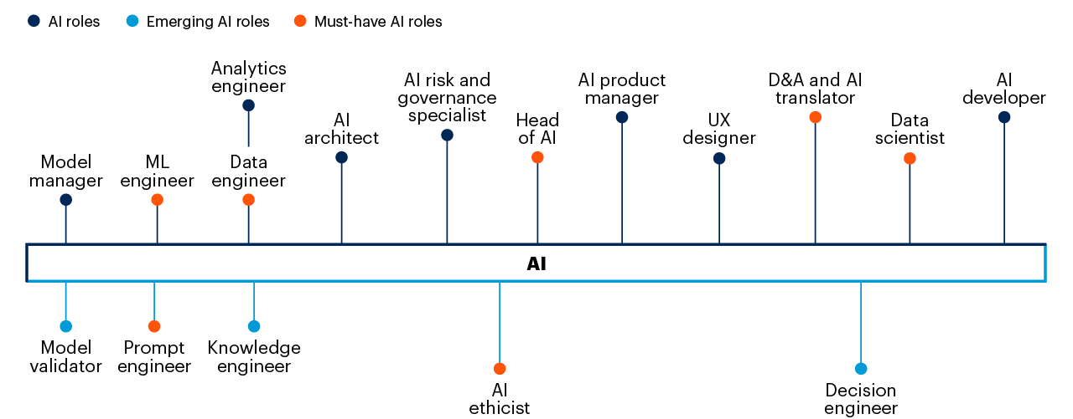
AI HIRING TRENDS
DFW ranked
7th
for most AI
job postings
in the U.S.
Sources: UMD-LinkUp AI Maps May 2025, Gartner (May 2024)

Slide 8





DFW IS THE #1 METRO IN TEXAS FOR
CARNEGIE-DESGINATED R1 UNIVERSITIES
Center for Digital and Human-Augmented Manufacturing
Center for Applied AI and Machine Learning
Center for Artificial Intelligence and Big Data
Trustworthy &
Responsible AI Network
Center of Electric, Connected and Autonomous Technologies for Mobility

Slide 9
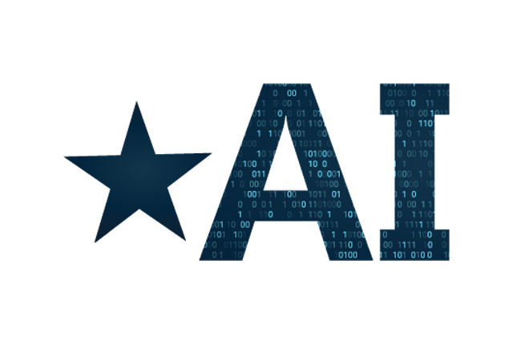




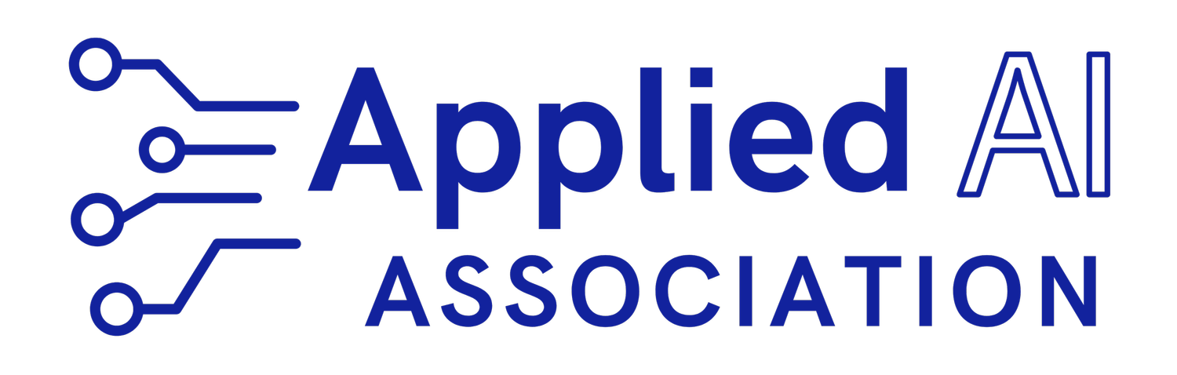

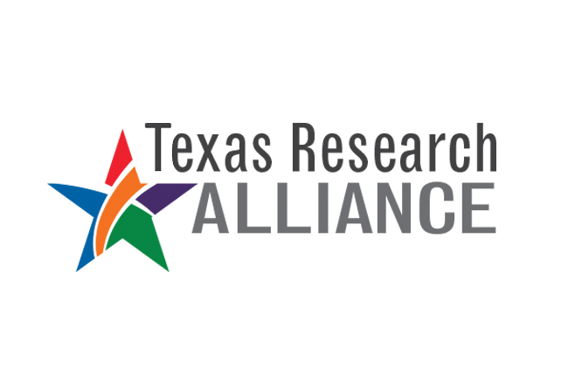



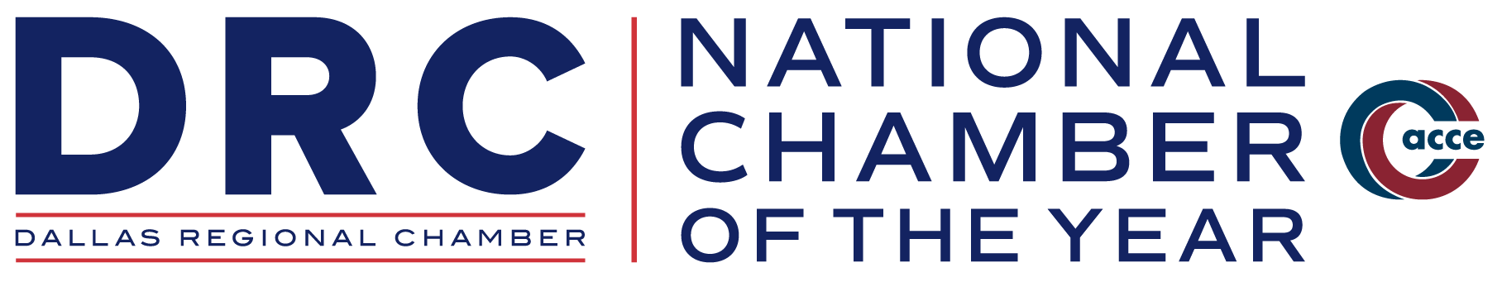


DFW AI COMMUNITY
www.dallasinnovates.com

Slide 10
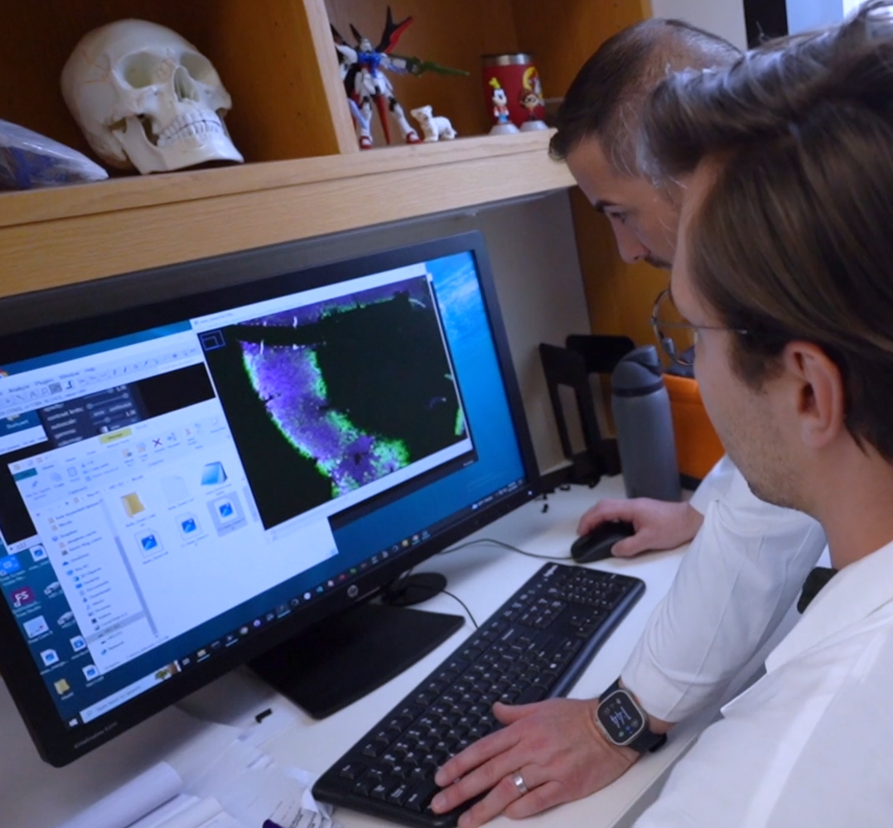
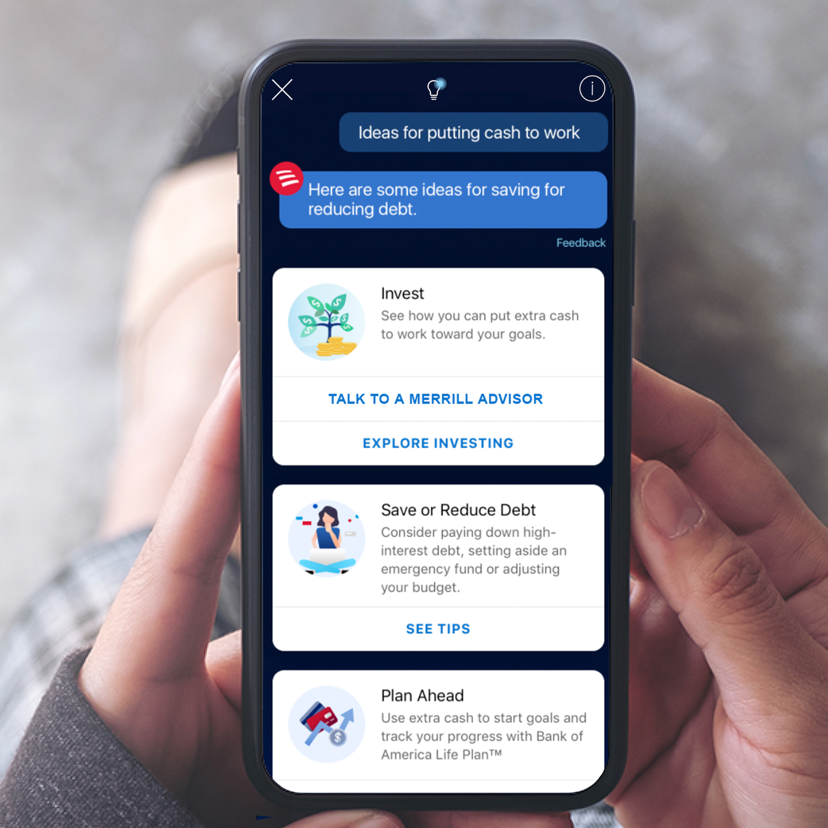
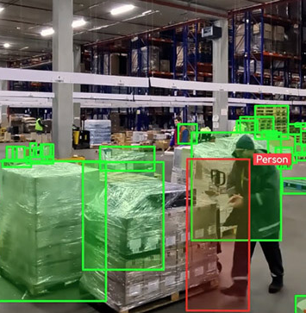
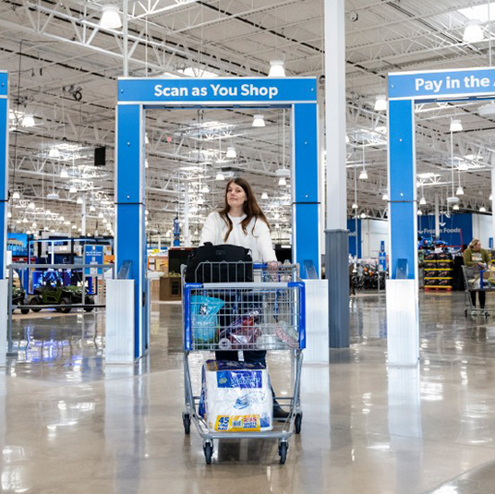
DFW AI HOTSPOTS
Health Care &
Biotech
Finance
Logistics and
Mobility
Retail

Slide 11
DRC AI PROGRAM OF WORK
Building AI Expertise to Support DRC Members
Supporting AI Initiatives in K-12
Working with Universities through the Texas Research Alliance
Monitoring State and Federal AI Legislation
Celebrating the Most Innovative People - Dallas Innovates AI 75
Convened 2nd Annual Convergence AI Dallas Conference in May 2025
Launched AI Office Hours

Slide 12
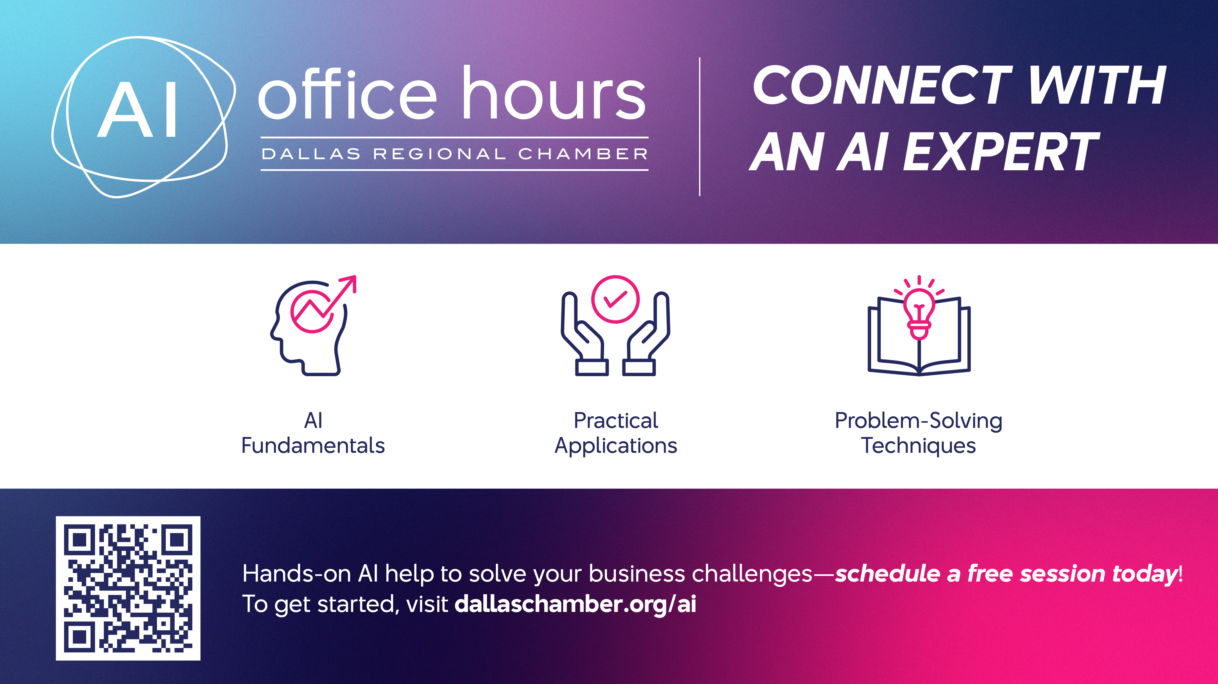
Notes:
As part of our ongoing effort to support AI adoption across the region, the Dallas Regional Chamber (DRC) has launched AI Office Hours
This is a platform that connects anyone, members and non-members, with local AI Experts for a free one-on-one virtual session
The experts come from DRC Member Consulting Firms
The idea is simple: not every company has in-house AI expertise, especially small and medium sized businesses,
but many are trying to understand how tools like ChatGPT can fit into their operations.
Through this initiative, anyone can schedule a free, hour-long session with an expert to ask questions, discuss strategy, or talk through technical challenges.
It’s a low-barrier, high-impact way to help companies of all sizes start or continue their AI journey
It reinforces the DRC’s role as a connector across the business community and is made possible by the generous investments of companies in the Dallas Regional Chamber’s Tomorrow Fund
It’s simple to book a session, just visit dallaschamber.org/ai to get started

